Slide 1
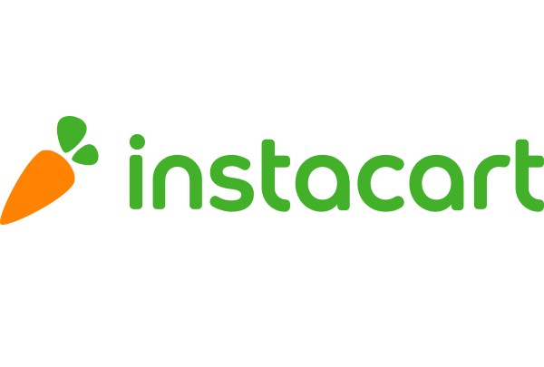


Recommendation and Market Basket Analysis
Supervised By: Dr. Doaa Mahmoud

Slide 2



Who are we?
2
Noran Hany
Toka Khaled

Slide 3


Motivation
3
Ecommerce is a very rich problem. A lot of rich insights, and ideas can be extracted. Also, new contributions can be added.

Slide 4
2
Problem
Definition
4
What's instacart?
Instacart, a grocery ordering and delivery app. After selecting products through the Instacart app, personal shoppers review your order and do the in-store shopping and delivery for you.

Slide 5
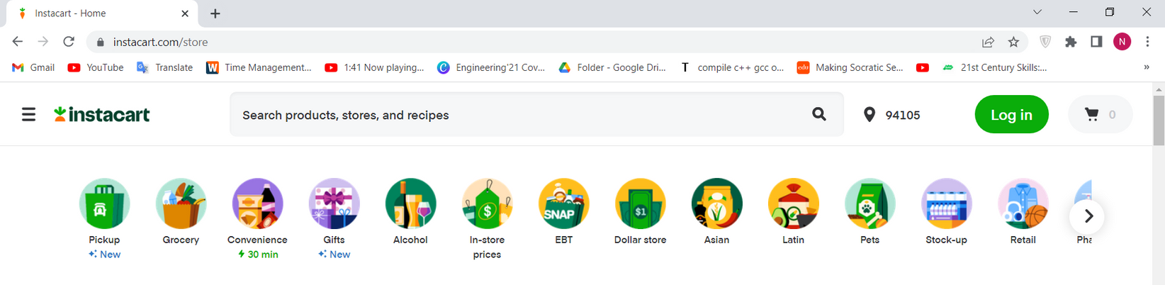
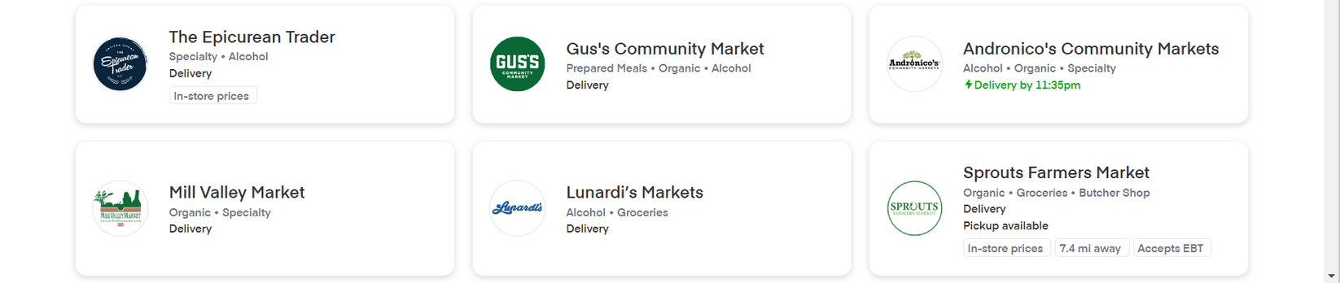
5
Problem Definition

Slide 6
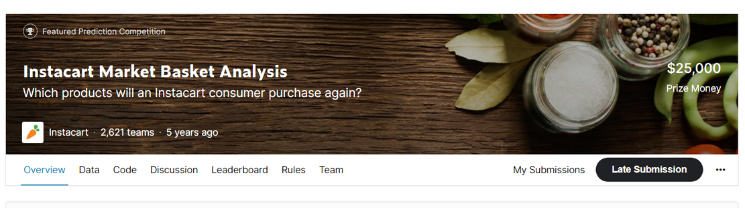
6
Problem Definition
At 2017, they Open Sourced for the first time 3 Millions instacart orders
They hosted a competition to use this anonymized data on customer orders over time to predict: which previously purchased products will be in a user’s next order?

Slide 7
2
7
Literature Review
We searched and investigated a paper and many kaggle notebooks. Contributors mainly worked on:
Customer Segmentation
Recommender Model
for next order
Association Rules
between products
Paper Link:
SESUG Paper 252-2019 | Market Basket Analysis on Instacart
Aravind Dhanabal,
Oklahoma State University

Slide 8
2
8
Literature Gap
Contributors didn't make good use of the time-dependent data provided.
Contributors we just using associations rules, for the sake of getting the rules. They didn't introduced how to make use of these rules from business point of view.

Slide 9
9
Data Description
Data is divided to 3 sets:
Prior data : Orders' history of every user.
Nearly 3–100 past orders per user
Train data : Future order data of every user.
Test data : Future order data of every user.

Slide 10
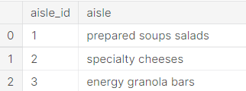
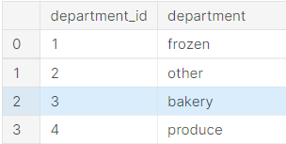
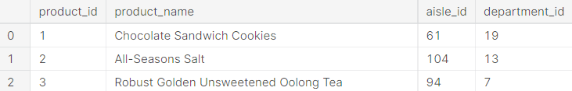
10
Data Description
Aisles [~134 sub-department]
Departments [~21department]
Products [~48K products]

Slide 11
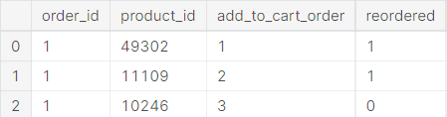
11
Data Description
Data is divided across 6 files:
order_products [2 files]
One for the basket of previously orders. [~33M rows]
Another for the basket of the future orders.

Slide 12
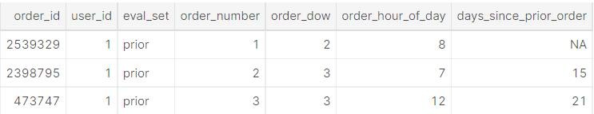
12
Data Description
orders [~3M orders]

Slide 13
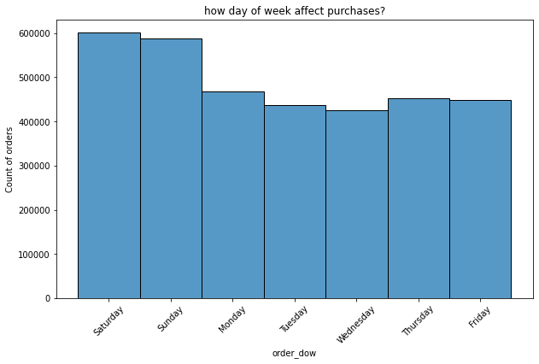
13
EDA
Days of week column only have numbers from 0-6
It didn't hold, which number correspond to which day of week
From the days of week histogram, Most orders were purchased on Day 0 and Day 1.
Thus we inferred that these 2 days seems to be the weekend.

Slide 14
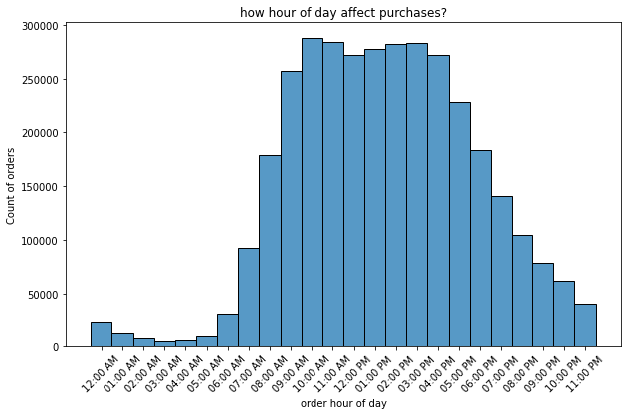
14
EDA
Intuitively, orders are mostly ordered during day, from 9:00 AM to 4:00 PM.

Slide 15
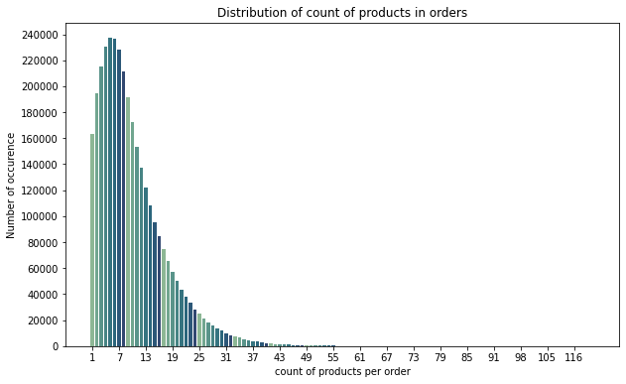
15
EDA
Most baskets contain from 5-8 products.

Slide 16
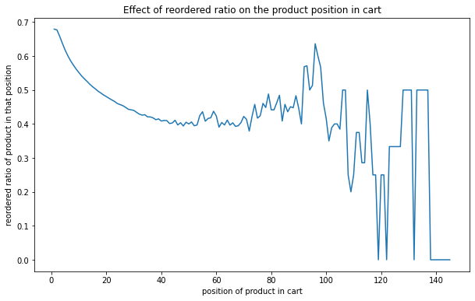
16
EDA
Intuitively, products placed first in cart are the products mostly reordered.
People tend to put first the products they already know.

Slide 17
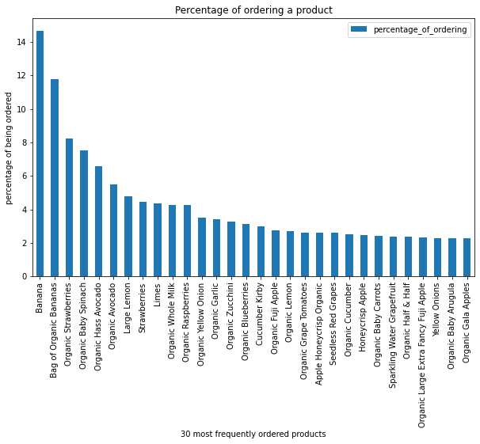
17
EDA
Analyzing products
5 Most Ordered Products
Banana
Bag of Organic Bananas
Organic Strawberries
Organic Baby Spinach
Organic Hass Avocado
14% of all purchases are bananas.
Organic products are frequently ordered.

Slide 18
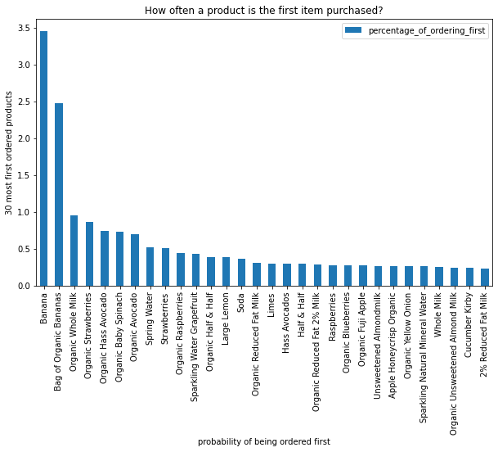
18
EDA
Analyzing products
From all purchases, how often a product is the first item purchased?
3.4% of the orders, Banana is the first product added to cart.
Intuitive, since banana is frequently bought.
Let's find another metric to measure how often a product is first placed!

Slide 19
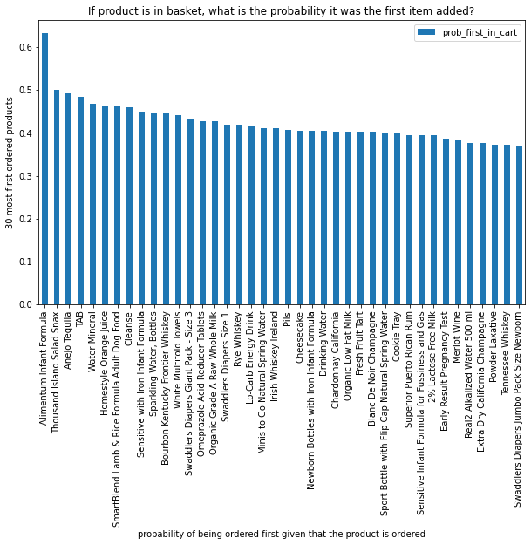
19
EDA
Analyzing products
Products which have been bought more than 100 times. From the orders the product only exist in, how often people put it first?
Didn't find a pattern or product if exists in basket, it will always be the first placed.

Slide 20
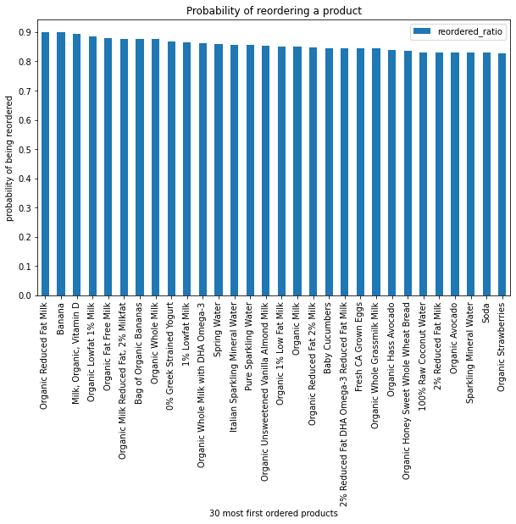
20
EDA
Analyzing products
For products which has over 10k purchases, we found products that most their purchases are from users who bought them before.
These products that when a customer buys, he/she will most probably buy again.
E.g. Count of total Organic Reduced Fat Milk purchases: ~36k
Count of reordered Organic Reduced Fat Milk purchases: ~31k

Slide 21
21
EDA
Analyzing products
For products which has over 10k purchases, we found products that most their purchases are from users who bought them before.
These products that when a customer buys, he/she will most probably buy again.
E.g. Count of total Organic Reduced Fat Milk purchases: ~36k
Count of reordered Organic Reduced Fat Milk purchases: ~31k

Slide 22
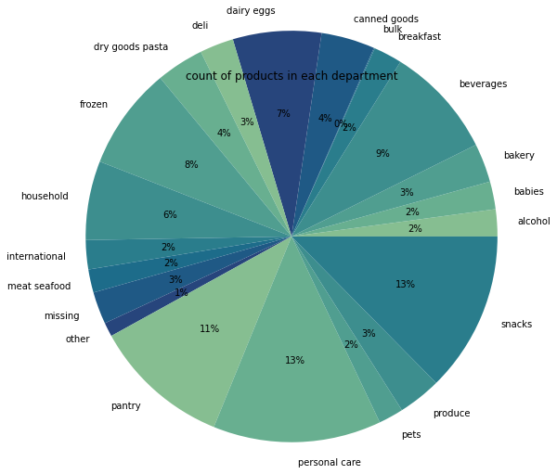
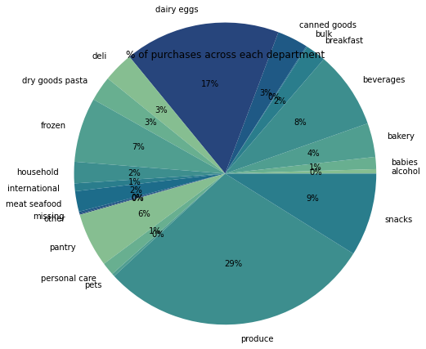
22
EDA
Analyzing departments
Distribution pf products across departments
Distribution pf purchases across departments
It seems that produce contains very few products ( 2% of the products), but 29% of total purchases.

Slide 23
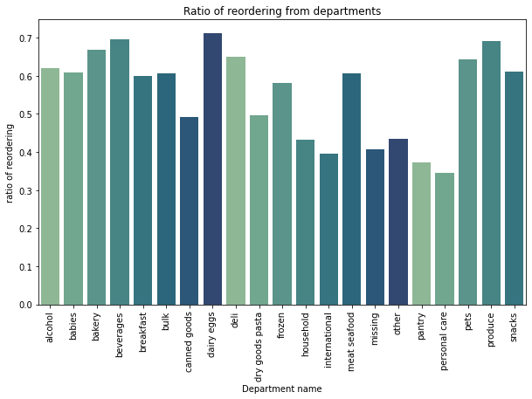
23
EDA
Analyzing departments
People how buy products from dairy eggs and produce will most probably buy them again.

Slide 24
24
Business Questions
How to make customers never forget instacart?
Which aisle or department to consider adding or offering more products to it?
When to avoid recommending new products?
When it's best to recommend a customer new products or a less frequently bought product?
When to recommend customized products to a user?
When is it most beneficial to both customer and business to make free coupons and offers?

Slide 25
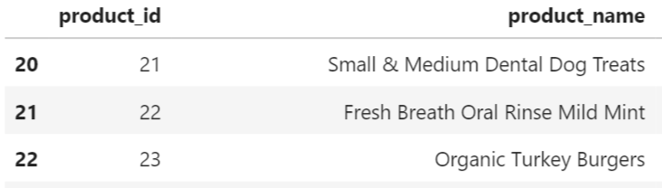
25
Business Questions
Which aisle or department to consider adding or offering more products to it?
We found that some product names holds "organic" in them! So we decided to analyze them.

Slide 26
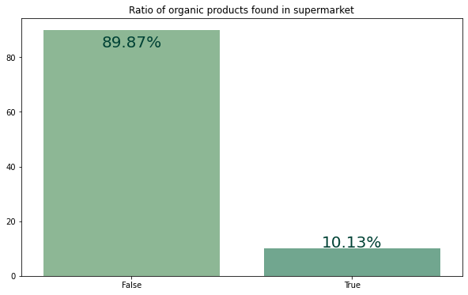
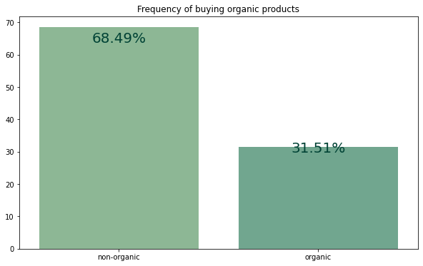
26
Business Questions
Analyzing organic products
They are few!
They are 31% of purchases!

Slide 27
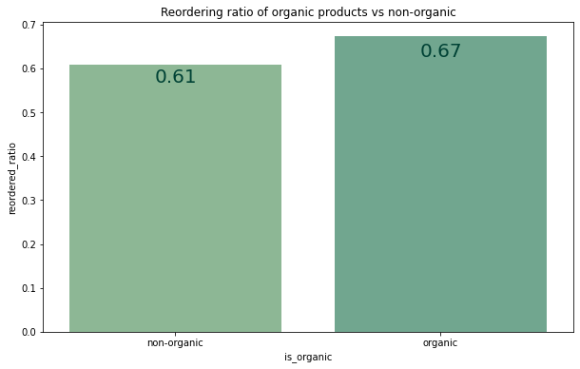
27
Business Questions
Analyzing organic products
67% of organic purchases are users who previously experienced and bought these products.
People are loving them!

Slide 28
28
Business Questions
Which aisle or department to consider adding or offering more products to it?
Introducing new organic products to instacart’s retailers portfolio.
Consider introducing new products in the departments that offer few product choices, but these products are highly being purchased.

Slide 29
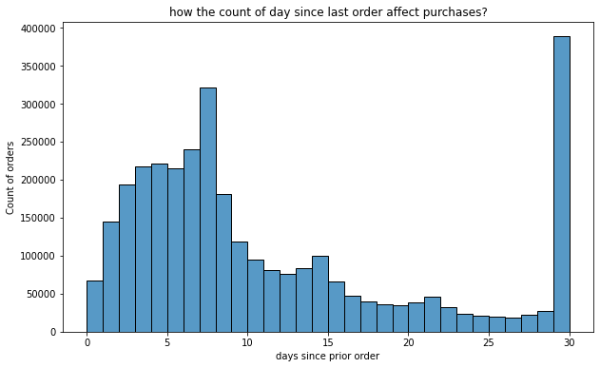
29
Business Questions
How to make customers never forget instacart?
Most users make orders after a week from their last order.
Send reminders to users who haven’t ordered since 7
days from their last order.

Slide 30
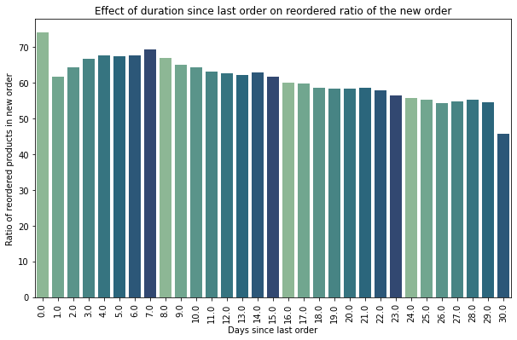
30
Business Questions
When to avoid recommending new products?
When it's most safe to recommend the user products they already know?
74 % of products bought at the same day of prev order, are reorders.
69% of products bought after one week from the previous order are reorders.
These are good timings to recommend products that have highly reordering
ratio

Slide 31
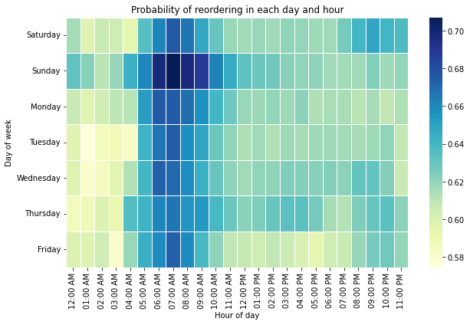
31
Business Questions
When to avoid recommending new products?
By more than 65%, People usually buy previously ordered products from 6:00AM to 8:00AM
Recommend previously ordered products at these hours, while avoiding recommending new products at these hours.

Slide 32
32
Business Questions
Who should we avoid recommending new products?
We found that 685 users always buy previously ordered products. starting from their 2nd order they never buy something new.
Users with strong behavior!
E.g. user_id 197064

Slide 33
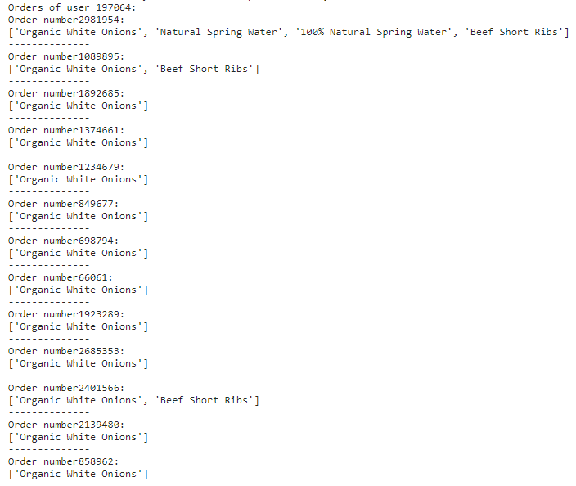
Purchases of user_id 197064
33

Slide 34
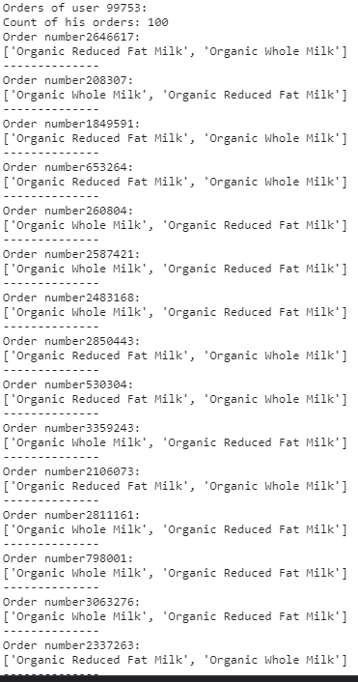
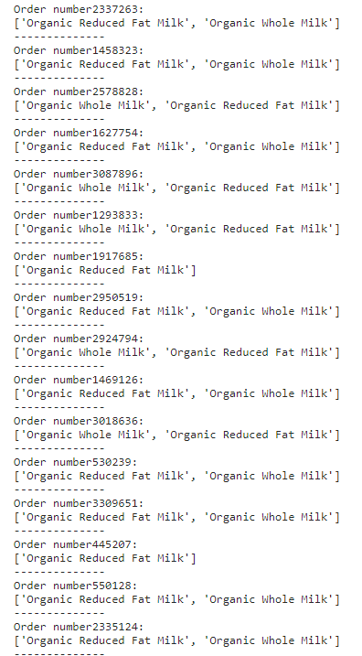

Purchases of user_id 99753
100 Orders, all contian MILK?
34

Slide 35
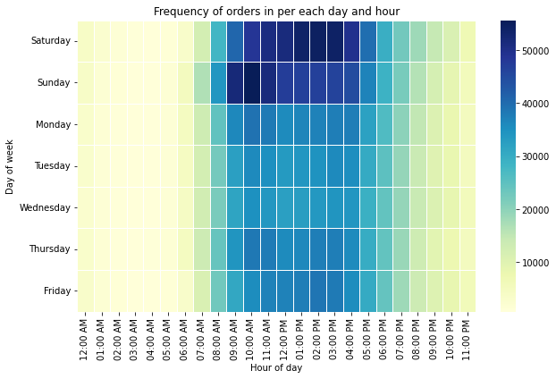
35
Business Questions
When it's best to recommend a customer
new products he/she never tried?
or a less frequently bought product?
Probability of a user buying during the afternoon of the weekends is high.
Thus can target the weekends to recommend users to try new products they haven’t bought before.

Slide 36
36
Predictive Analysis Model
Problem formulation
What do we want? We want to predict the products that will be in user's next future order.
Forming the data: We take each user with his/her previously ordered products, and form each record to be a user-product pair.
Then predict a boolean, wether this user will order or not this product in his/her future order.
Let's extract features that relate to this user-product pair.

Slide 37
37
Feature Engineering
We wanted to extract features that strongly describe the relation between user and product
User-product features
Remember from analysis, product placed first, has high probability of being reordered.
up_average_cart_position: The average position in a user's cart of a
product
up_order_rate_since_first_time: measures the degree a user like a product. It's the ratio by which a user will buy a product from the first moment he/she knew about it.
up_orders_since_last_order: measures how long the user hasn't considered buying a specific product.

Slide 38
38
Feature Engineering
User-product features
up_first_order: What was the first time a user purchased a product
up_order_rate: Percentage of user’s orders that include a specific product
User features
user_orders: count of user's orders. We can rely more on data obtained from users who purchased many orders.
user_reorder_ratio: measures how this user is likely to buy something new!
user_average_basket: how many products user put on average.
user_period: how many days since the user starts shopping at instacart.
user_mean_days_since_prior: how many days passed since last order.

Slide 39
39
Feature Engineering
Products features
prod_freq: Total number of orders per product.
prod_reorder_ratio: Ratio that this product is being reordered from all purchases.
user_prod_avg_freq: In average how many times a product has been purchased by the users who purchased it at least once.

Slide 40
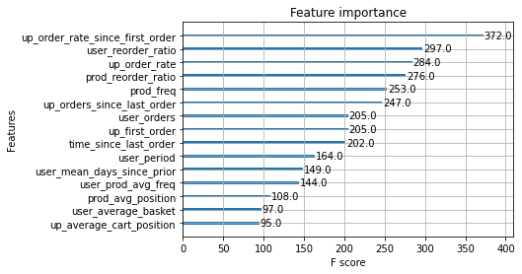
40
Feature Engineering
Product Features
prod_avg_position: The position in cart mostly repeated for the product
From analysis, we already knew that prod_avg_position is not an indicator or good feature. Since we found no product that is always placed first in cart.

Slide 41
41
Predictive Analysis Model
Classes are imbalanced
Data is very skewed to the negative class. Class distribution: 10 negative points to 1 positive point.
Train Set positive class count: 579915.0
Train Set negative class count: 5352347.0

Slide 42
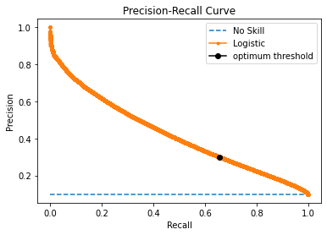
42
Predictive Analysis Model
First, we've found that there's a lot of false negatives
So we wanted to reduce the number of products the model say user won't predict in the future while he/she will actually does.
On the other side, it's okay to allow some false positives, when the model recommends a products the user will less likely buy in his/her next order.
We changed the threshold to maximize the recall, while keeping the precision above a certain threshold 0.3

Slide 43
43
Predictive Analysis Model
Feature importance without time features

Slide 44
2
44
Another Question
When is it most beneficial to both customer and business to make free coupons and offers?
How to group products in offers?

Slide 45
45
Future work
Improve the Time-dependent features we worked on.

Slide 46
46
Predictive Analysis Model
Time-dependent features
Difference between
On avg the hour the user buys this product at - The future order hour.
On avg which day of week the user buys this product at - The future order's day of week.
On avg the hour the product is most bought at - The future order hour.
On avg which day of week the product is most bought at - The future order's day of week

Slide 47
47
Predictive Analysis Model
Time-dependent features
We faced a problem calculating difference and averages between times.
Saturday takes 0
and Friday takes 6
However, they are not 6 days apart! They're 1 day apart.
How we implemented this?

Slide 48
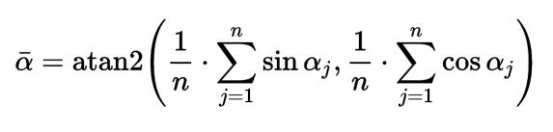
48
Predictive Analysis Model
Time-dependent features
Changed numbers to angles, since angles have a cyclic property.
Then averaged the angles using the following formula:
Then changed the average angle to number.

Slide 49
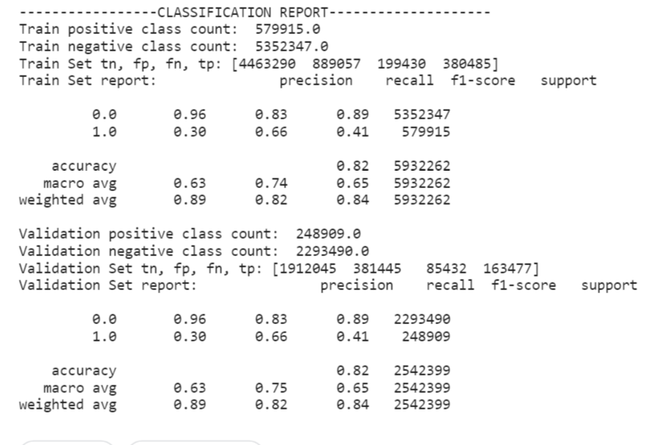
49
Predictive Analysis Model
Performance
Classification report

Slide 50
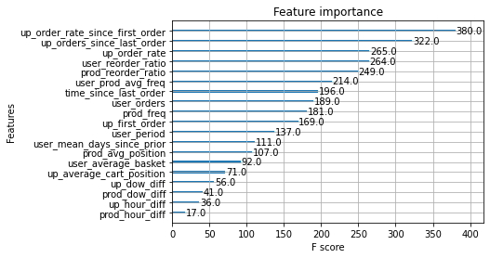
50
Predictive Analysis Model
Time-dependent didn't perform well

Slide 51
51
Citation
“The Instacart Online Grocery Shopping Dataset 2017”, Accessed from https://www.instacart.com/datasets/grocery-shopping-2017 on 2022, May

